Slide 1
THE ML / DL HANDBOOK · COMPANION SERIES, VOLUME VI
Recurrent Neural Networks
Memory Over Time — the RNN, the LSTM, and the GRU
Vanilla RNN
Vanishing gradients
LSTM gates
GRU
RNN vs. Transformer
Chapter 19 · Sequences, hidden state, and the fight against vanishing gradients

Slide 2
ROADMAP
01
Why sequences break feedforward nets
02
The RNN idea — and the cell, opened up
Order carries meaning that a bag of features throws away
A loop that carries a hidden state, with every weight matrix named
03
Why vanilla RNNs forget
04
LSTM — a conveyor belt for memory
Backpropagation through time and the vanishing gradient
The RNN in gate form, then three gates and an additive update
05
GRU — the streamlined cousin
06
Choosing: RNN, LSTM, GRU or Transformer
Two gates, one carried vector, ~25% fewer parameters
When each architecture actually wins
Vol. VI · Ch. 19 — Recurrent Networks, LSTM & GRU
2

Slide 3
19.1 — THE PROBLEM
Language is a sequence, not a set
A feedforward network sees all of its inputs at once, in no particular order. That is fine for a photograph. It is fatal for a sentence.
SAME WORDS, OPPOSITE MEANING
“Dog bites man”
IN PLAIN ENGLISH
We need a network with memory — one that reads the input one piece at a time and carries forward a running summary of everything it has already seen.
vs.
“Man bites dog”
What that memory has to do
Exactly the same words — entirely different meaning. A model that only counts features cannot tell them apart. Order is the signal.
— survive from one word to the next
— be updated, not overwritten, at every step
— be the same size no matter how long the sentence is
Vol. VI · Ch. 19 — Recurrent Networks, LSTM & GRU
3

Slide 4
19.2 — THE CORE IDEA
A loop that carries state
A recurrent neural network processes a sequence one step at a time and keeps a hidden state — a vector that acts as a running summary of everything seen so far.
1
2
3
→
→
Take two things
Combine them
Pass it forward
the new input x, and the previous hidden state h
into an updated hidden state, using one shared set of weights
the updated state feeds the next step — forming a loop through time
THE ANALOGY WE WILL KEEP USING
Think of the hidden state as a sticky note the network rewrites after every word. It never sees the whole sentence at once — all it ever has is the current word plus whatever it managed to write down about everything before it.
Vol. VI · Ch. 19 — Recurrent Networks, LSTM & GRU
4

Slide 5
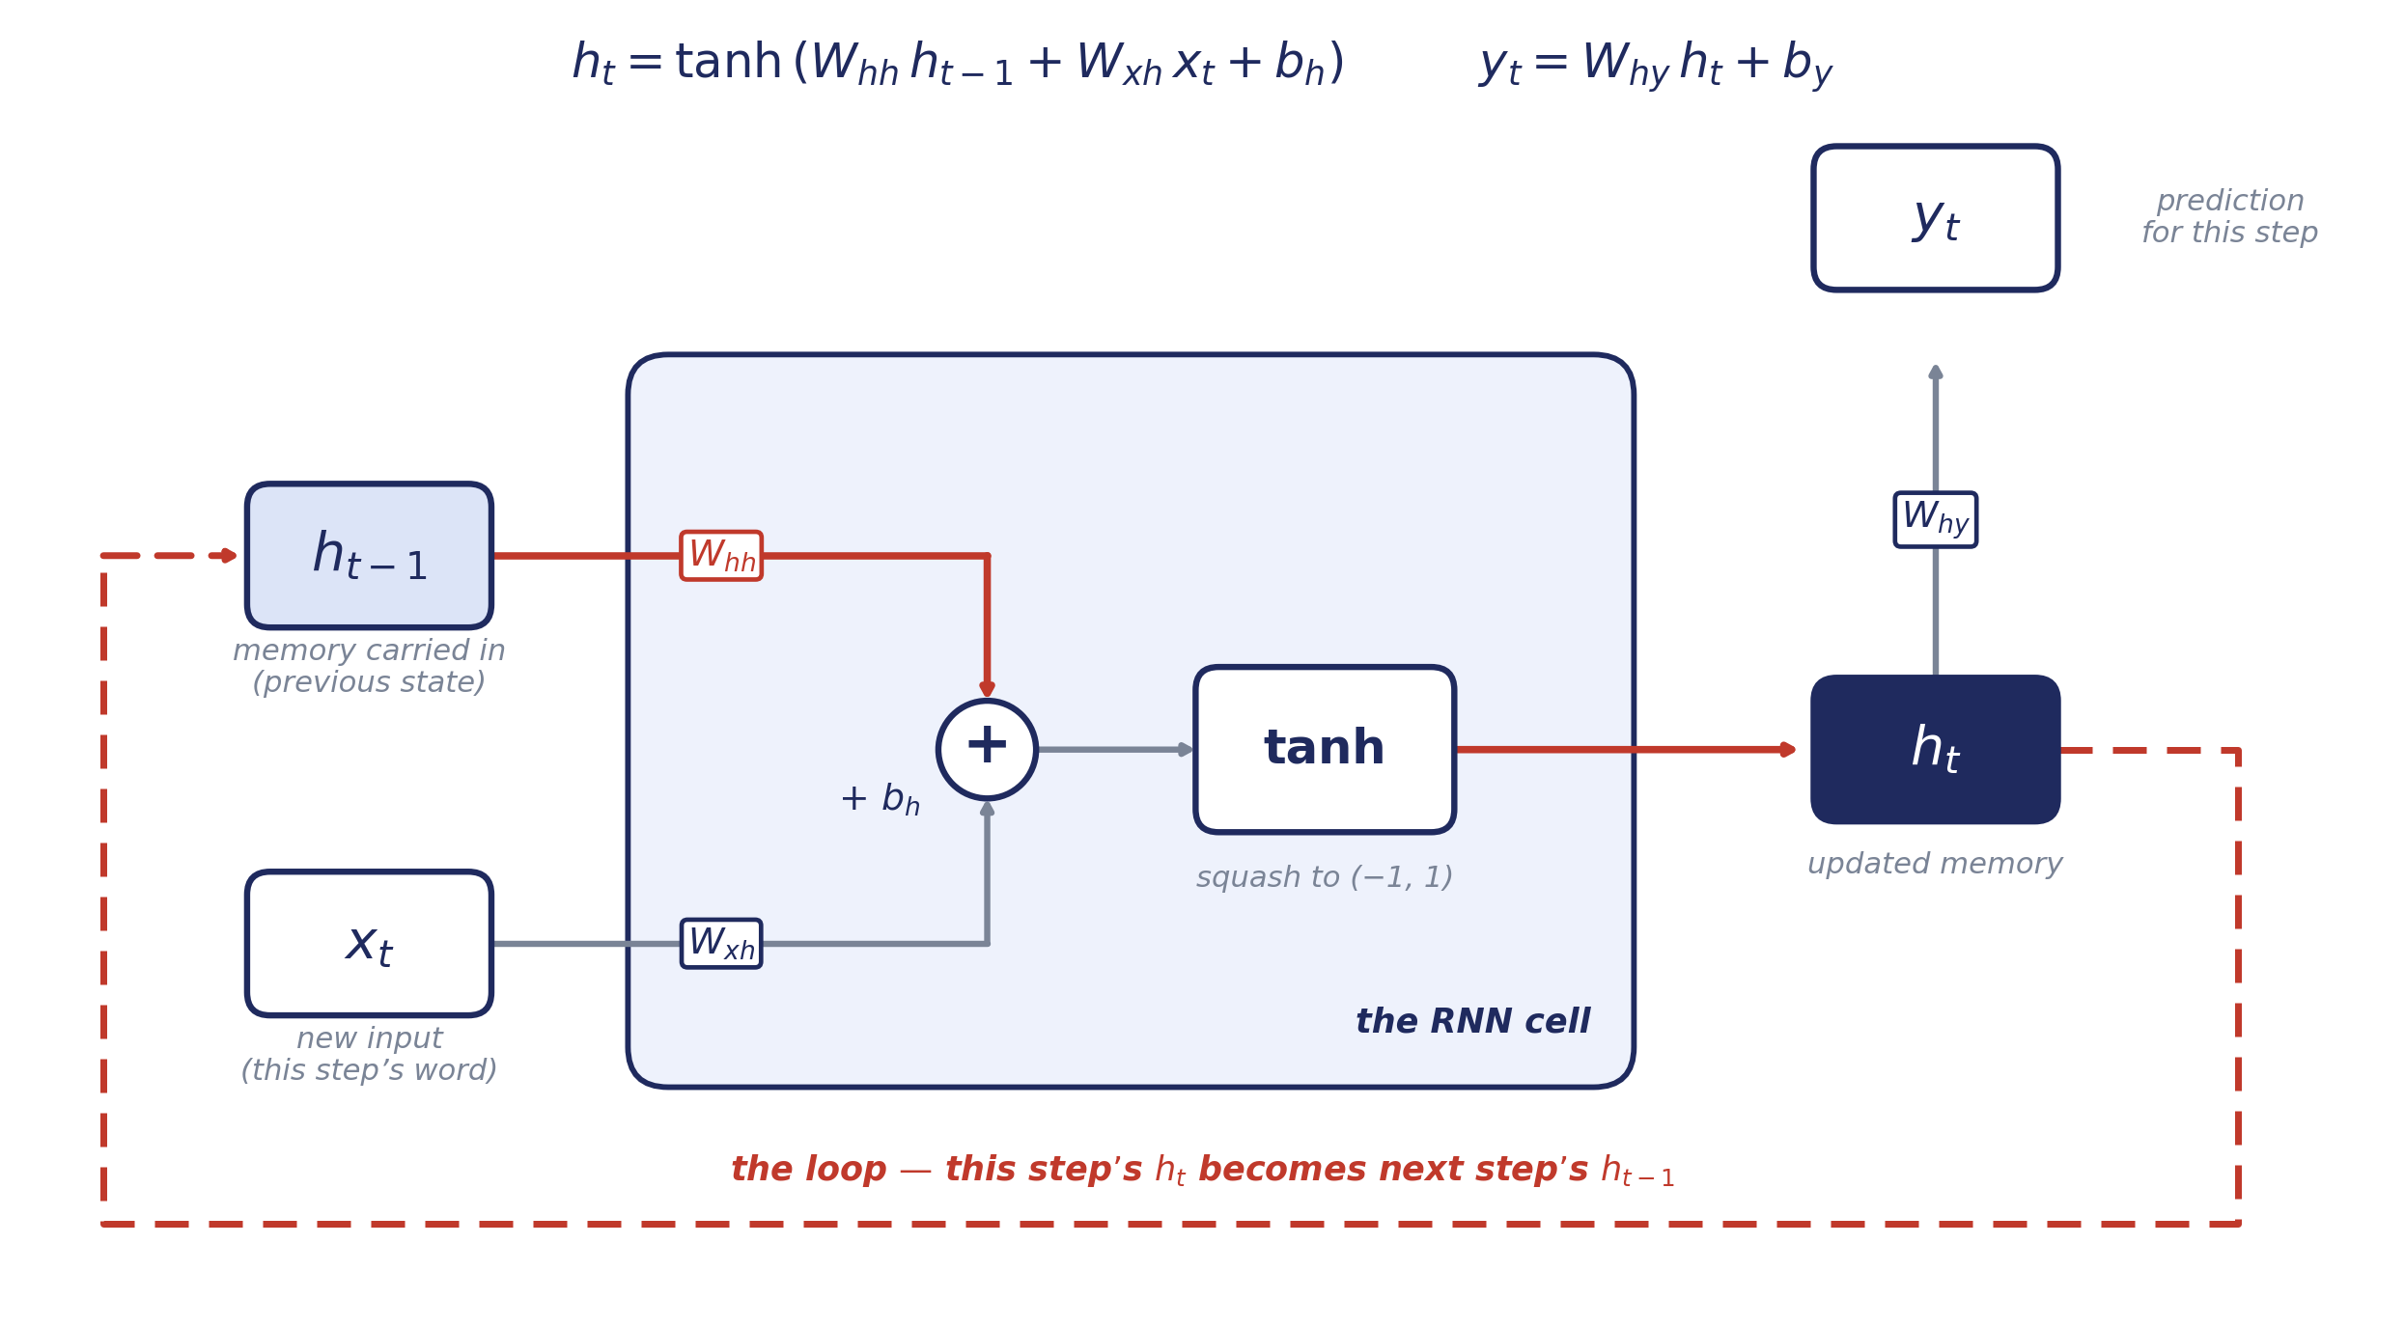
FIGURE 19.1
The RNN cell, opened up
Three weight matrices, one bias, one squashing function. Everything an RNN is, on one page.
Vol. VI · Ch. 19 — Recurrent Networks, LSTM & GRU
5

Slide 6
READING THE DIAGRAM
What each weight matrix is for
Every arrow that changes the shape of a vector has a matrix on it. There are only three.
W_{xh}
Turns this step’s input into something in the memory’s own language. Shape h × d.
input → hidden
W_{hh}
Decides how the old memory is reshaped before the new input is mixed in. This is the matrix that will cause all the trouble later. Shape h × h.
hidden → hidden
W_{hy}
Reads a prediction out of the memory. Shape (output size) × h.
hidden → output
WHY THE SHAPES MATTER
h is the hidden size you choose; d is the size of one input. Notice that none of these shapes mention the length of the sequence — that is the whole point.
Vol. VI · Ch. 19 — Recurrent Networks, LSTM & GRU
6

Slide 7
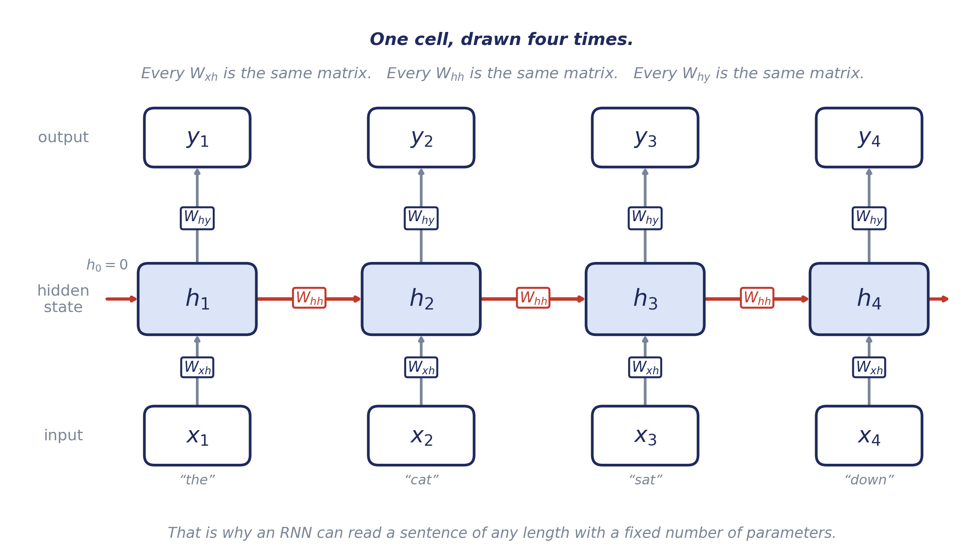
FIGURE 19.2
The same cell, unrolled across time
Words arrive one at a time; the hidden state is passed forward, accumulating a memory of the sequence.
Vol. VI · Ch. 19 — Recurrent Networks, LSTM & GRU
7

Slide 8
19.3 — THE RECURRENCE
The update, written precisely
Step 1 — hidden-state update
READ IT LEFT TO RIGHT
h_{t} = tanh( W_{hh} h_{t−1} + W_{xh} x_{t} + b_{h} )
1 take the old memory, reshape it with the h-matrix
2 take the new word, reshape it with the x-matrix
3 add them, plus a bias
4 squash the result into (−1, 1) with tanh
the new memory, built from old memory + new input
Step 2 — output at each step
y_{t} = W_{hy} h_{t} + b_{y}
the prediction is simply read off the current hidden state
PARAMETER SHARING ACROSS TIME
Exactly as a CNN shares one filter across every position in an image, an RNN shares one set of weight matrices across every timestep. The network does not learn a rule for “word 3” — it learns one rule and applies it everywhere. That is why a fixed number of parameters can read a sentence of any length.
Vol. VI · Ch. 19 — Recurrent Networks, LSTM & GRU
8

Slide 9
19.4 — THE FAILURE MODE
Why vanilla RNNs forget
To train an RNN you unroll it across all timesteps and backpropagate through the whole chain — backpropagation through time. Because the same W_hh is applied at every step, the gradient flowing backwards is multiplied by that same matrix once per step.
∂L_{t} / ∂h_{k} = ( ∂L_{t} / ∂h_{t} ) · ∏ ∂h_{j} / ∂h_{j−1} ( j = k+1 … t )
the gradient must travel back through a product of one Jacobian per step
∏ ∂h_{j} / ∂h_{j−1} ∝ ( W_{hh} ᵀ )ⁿ
the same matrix, multiplied by itself n times — governed by |λmax|, its spectral radius
gradient ~ |λmax|ⁿ → 0 when |λmax| < 1 — it vanishes with distance n
In practice a vanilla RNN loses the thread after roughly ten steps.
IN PLAIN ENGLISH
Multiply by 0.9 twenty times and 0.12 is left. Multiply by 0.5 and one in a million is left.
Vol. VI · Ch. 19 — Recurrent Networks, LSTM & GRU
9

Slide 10
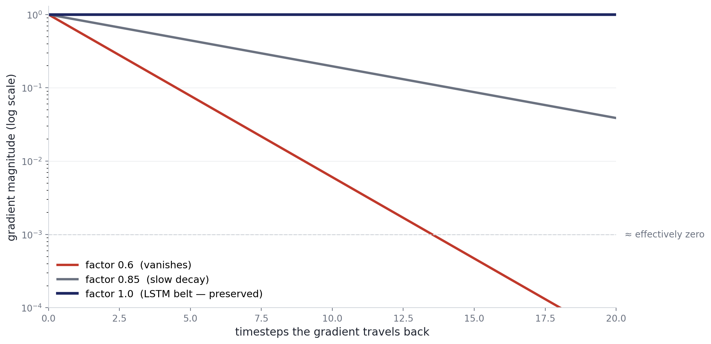
FIGURE 19.3
Repeated multiplication kills the gradient
Multiply by a number smaller than one, twenty times over, and there is nothing left to learn from.
Vol. VI · Ch. 19 — Recurrent Networks, LSTM & GRU
10

Slide 11
FROM RNN TO LSTM
Keep the memory. Lose the matrix.
The problem was never memory itself — it was that every step forced the memory through a weight matrix. The fix is to give the memory a lane of its own where nothing multiplies it, and let small gates decide what gets added to it and what gets erased.
Vol. VI · Ch. 19 — Recurrent Networks, LSTM & GRU
11

Slide 12
19.5 — THE FIX
LSTM — a conveyor belt for memory
The Long Short-Term Memory network (Hochreiter & Schmidhuber, 1997) was engineered specifically to defeat the vanishing gradient.
A second lane
Only small edits
Gates decide
Alongside the hidden state h, the LSTM carries a cell state C — a vector that runs the length of the sequence like a conveyor belt.
Nothing multiplies the belt by a weight matrix. Each step may scale it and add to it, and that is all.
Three little sigmoid networks decide, per component, what to erase, what to write, and what to reveal.
THE PICTURE TO HOLD ON TO
Picture a long strip of paper running past you. You may rub bits out, you may write new bits on, but you never re-copy the whole strip. Whatever you leave alone arrives at the far end exactly as it started.
Vol. VI · Ch. 19 — Recurrent Networks, LSTM & GRU
12

Slide 13
19.6 — THE THREE GATES
What controls the belt
A gate is a sigmoid layer that looks at the current input and the previous hidden state and outputs a number between 0 and 1 for every component of memory — 0 means block completely, 1 means let through completely.
GATE
THE QUESTION IT ANSWERS
WHAT IT DOES TO THE BELT
Forget f
What should I erase from memory?
multiplies the belt by ≈0 (forget) or ≈1 (keep)
Input i
How much new information should I write?
scales the candidate before it is added on
Output o
What part of memory should I expose right now?
reads out a filtered view as the hidden state
IN PLAIN ENGLISH
A gate is not a switch — it is a dimmer, and there is one dimmer per number in the memory vector.
Vol. VI · Ch. 19 — Recurrent Networks, LSTM & GRU
13

Slide 14
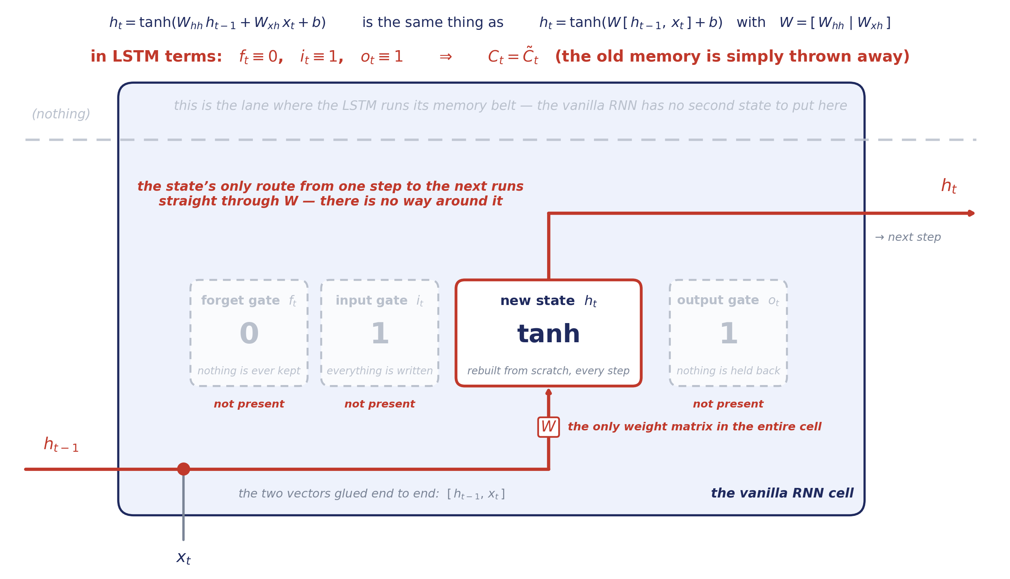
FIGURE 19.4
The vanilla RNN, in gate form
The same template we are about to use for the LSTM — so you can see exactly what the LSTM adds.
Vol. VI · Ch. 19 — Recurrent Networks, LSTM & GRU
14

Slide 15
READING THE DIAGRAM
An LSTM with its gates welded shut
Written in gate language, the vanilla RNN is not a different family of models — it is the degenerate case.
f = 0
The forget gate is welded to zero, so the previous memory is multiplied away completely at every single step. Nothing survives on its own.
i = 1
The input gate is welded to one, so the fresh candidate is always written at full strength. The cell has no way to say “not yet”.
o = 1
The output gate is welded to one, so the whole state is exposed. There is no private memory the cell keeps back.
WHY THAT IS THE WHOLE PROBLEM
Because f is pinned to 0 there is no additive path across time, so the gradient has nowhere to travel except back through W — once per step. The LSTM’s whole contribution is to let the network choose those three numbers.
Vol. VI · Ch. 19 — Recurrent Networks, LSTM & GRU
15

Slide 16
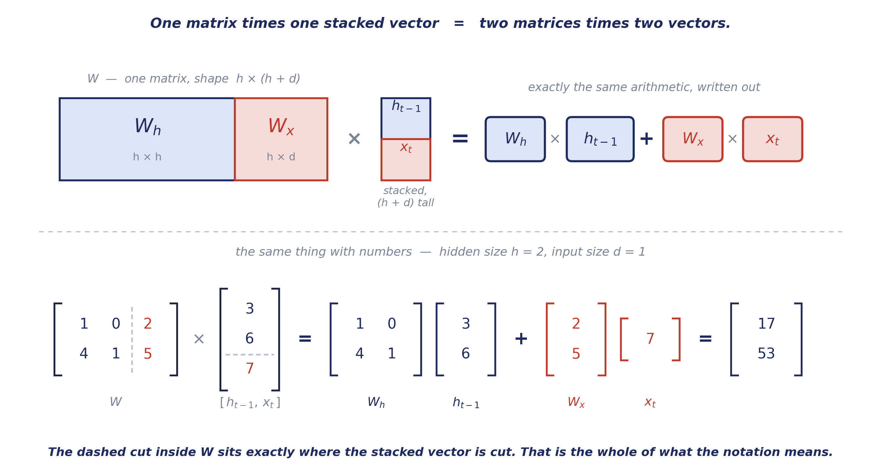
FIGURE 19.5
What W · [ h , x ] actually means
Before the LSTM equations arrive, one piece of notation is worth taking apart, because every gate uses it.
Vol. VI · Ch. 19 — Recurrent Networks, LSTM & GRU
16

Slide 17
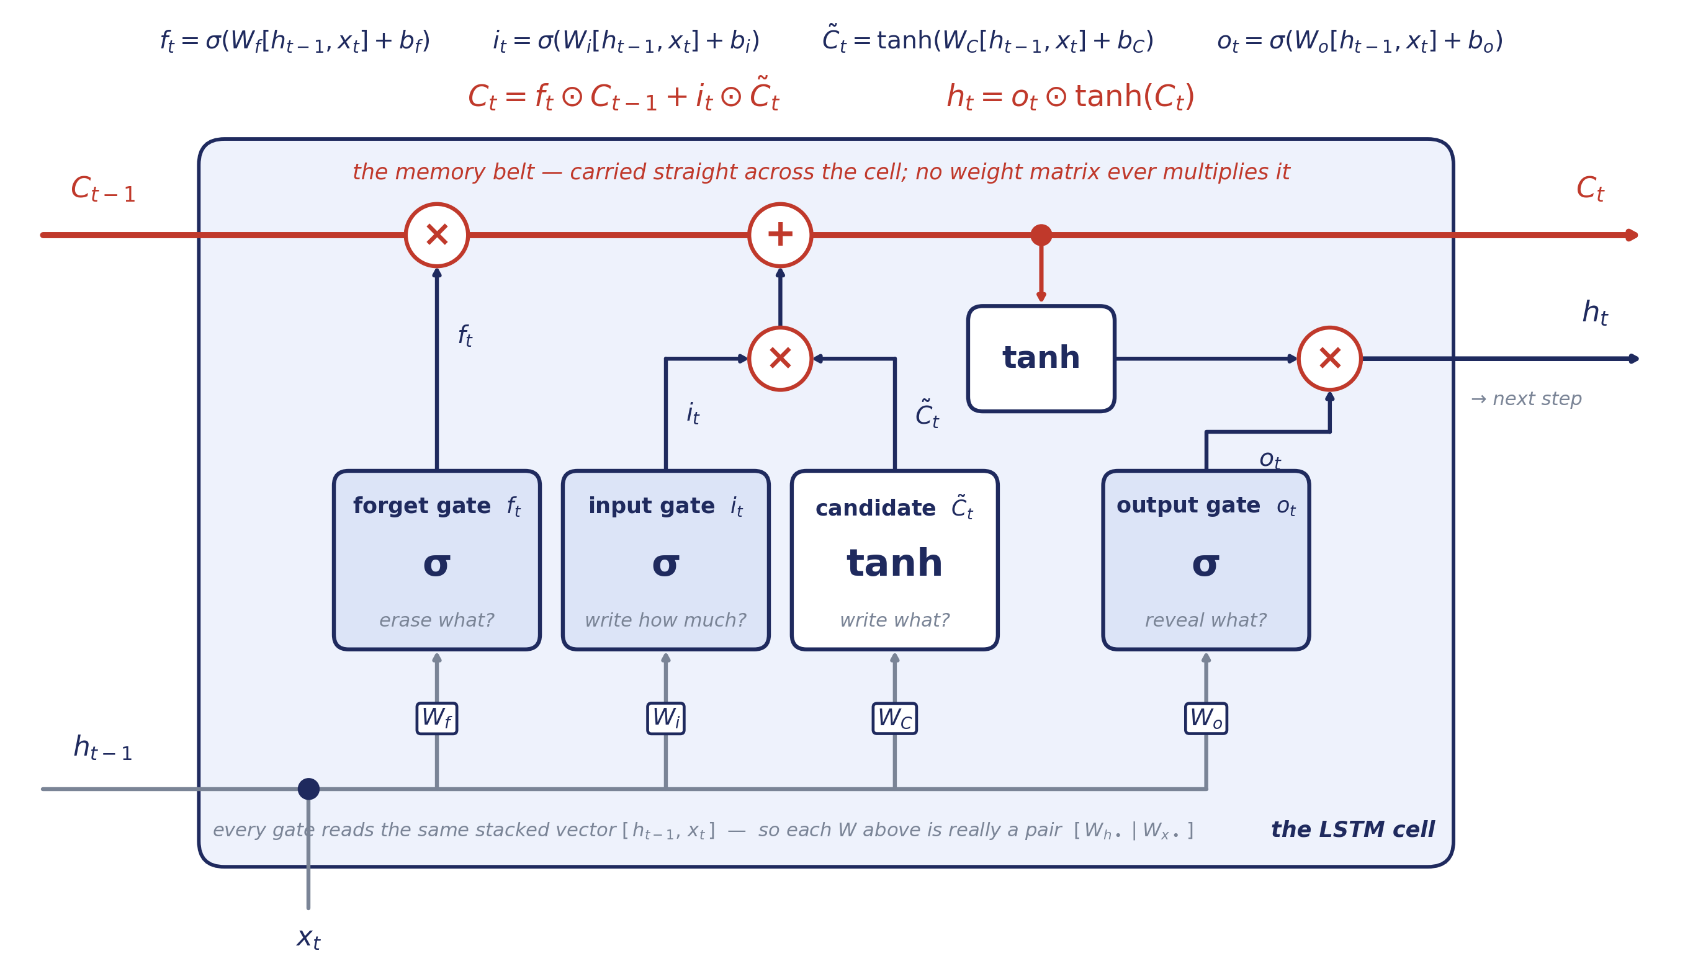
FIGURE 19.6
The LSTM cell, opened up
Four weight matrices, three gates, one belt. Follow the red line: it never passes through a matrix.
Vol. VI · Ch. 19 — Recurrent Networks, LSTM & GRU
17

Slide 18
READING THE DIAGRAM
Four matrices, four jobs
All four read the same stacked vector [ h_t−1 , x_t ], so all four have the same shape: h × (h + d).
W_{f}
forget gate
Produces f — how much of each slot on the belt survives this step.
THE TWO SYMBOLS ON THE BELT
×
elementwise multiply — the dimmer. Multiplying by the forget gate is how the belt gets erased.
W_{i}
input gate
Produces i — how strongly the new candidate is written on.
+
plain addition — the whole reason the gradient survives. Addition passes a gradient through untouched.
W_{C}
candidate
Produces C̃ — the content that could be written, squashed to (−1, 1).
W_{o}
output gate
Produces o — which parts of the belt become the visible hidden state h.
IN PLAIN ENGLISH
Everything else in the diagram is a σ (squash to 0–1, for gates) or a tanh (squash to −1–1, for content). No other matrices exist.
Vol. VI · Ch. 19 — Recurrent Networks, LSTM & GRU
18

Slide 19
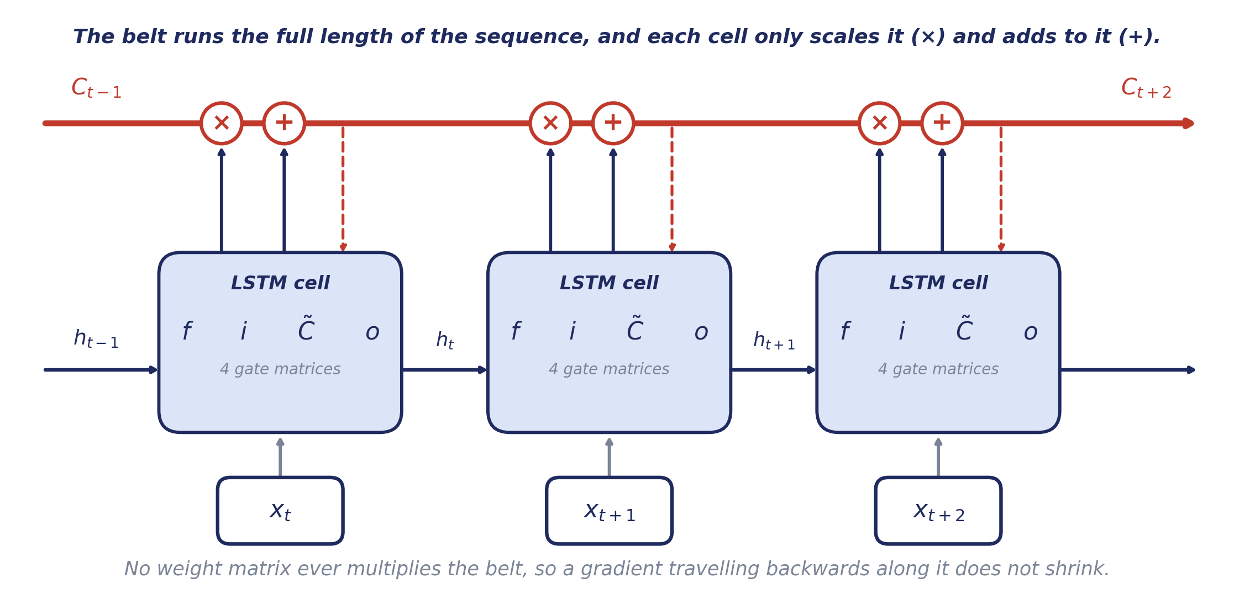
FIGURE 19.7
The belt, across three timesteps
The cell state is the only thing in the diagram that travels the whole length of the sequence untouched.
Vol. VI · Ch. 19 — Recurrent Networks, LSTM & GRU
19

Slide 20
19.7 — FORWARD PASS
The LSTM equations, line by line
Gates — sigmoid, output in [0, 1]
f_{t} , i_{t} , o_{t} = σ( W · [ h_{t−1} , x_{t} ] + b )
three separate matrices, one per gate; each answers a yes/no-ish question per slot
Candidate memory — tanh, output in (−1, 1)
C̃_{t} = tanh( W_{C} · [ h_{t−1} , x_{t} ] + b_{C} )
the content the cell would like to write, if the input gate lets it
Update the belt — this is the additive step
C_{t} = f_{t} ⊙ C_{t−1} + i_{t} ⊙ C̃_{t}
erase some of the old, add some of the new — no matrix touches C
Hidden state — the visible output
h_{t} = o_{t} ⊙ tanh( C_{t} )
the belt, squashed and filtered; this is what the next cell and the prediction see
Vol. VI · Ch. 19 — Recurrent Networks, LSTM & GRU
20

Slide 21
THE GATES, UNSTACKED
Every LSTM gate, written out in full
Each W in the diagram is a pair of matrices glued side by side. Split them apart and the stacking disappears.
AS DRAWN — ONE STACKED VECTOR
WRITTEN OUT — TWO MATRICES
f_{t}
σ( W_{f} · [ h_{t−1} , x_{t} ] + b_{f} )
σ( W_{hf} h_{t−1} + W_{xf} x_{t} + b_{f} )
i_{t}
σ( W_{i} · [ h_{t−1} , x_{t} ] + b_{i} )
σ( W_{hi} h_{t−1} + W_{xi} x_{t} + b_{i} )
C̃_{t}
tanh( W_{C} · [ h_{t−1} , x_{t} ] + b_{C} )
tanh( W_{hC} h_{t−1} + W_{xC} x_{t} + b_{C} )
o_{t}
σ( W_{o} · [ h_{t−1} , x_{t} ] + b_{o} )
σ( W_{ho} h_{t−1} + W_{xo} x_{t} + b_{o} )
READING THE SUBSCRIPTS
h-subscripted matrix: h × h, multiplies the memory. x-subscripted: h × d, multiplies the input. Papers often name the pair W and U instead.
Vol. VI · Ch. 19 — Recurrent Networks, LSTM & GRU
21

Slide 22
19.8 — THE PAYOFF
Why the additive belt saves the gradient
Differentiate C_t = f_t ⊙ C_t−1 + i_t ⊙ C̃_t with respect to C_t−1 and you get, simply, the forget gate — not a weight matrix.
∂C_{t} / ∂C_{t−1} = f_{t}
∂C_{T} / ∂C_{k} = ∏ f_{t}
gradient ~ ∏ f_t ≈ 1 when the network chooses to remember — no exponential decay
THE SAME TRICK AS RESIDUAL CONNECTIONS — EIGHTEEN YEARS EARLY
Because the cell state is updated by addition, the gradient travels along a path whose local slope is the forget gate — a number the network learns to set near 1 when memory matters — instead of a shrinking matrix power. That is precisely the additive skip-path that residual connections (2015) would later use to train very deep networks. The LSTM got there in 1997, in a different architecture, for exactly the same reason.
Vol. VI · Ch. 19 — Recurrent Networks, LSTM & GRU
22

Slide 23
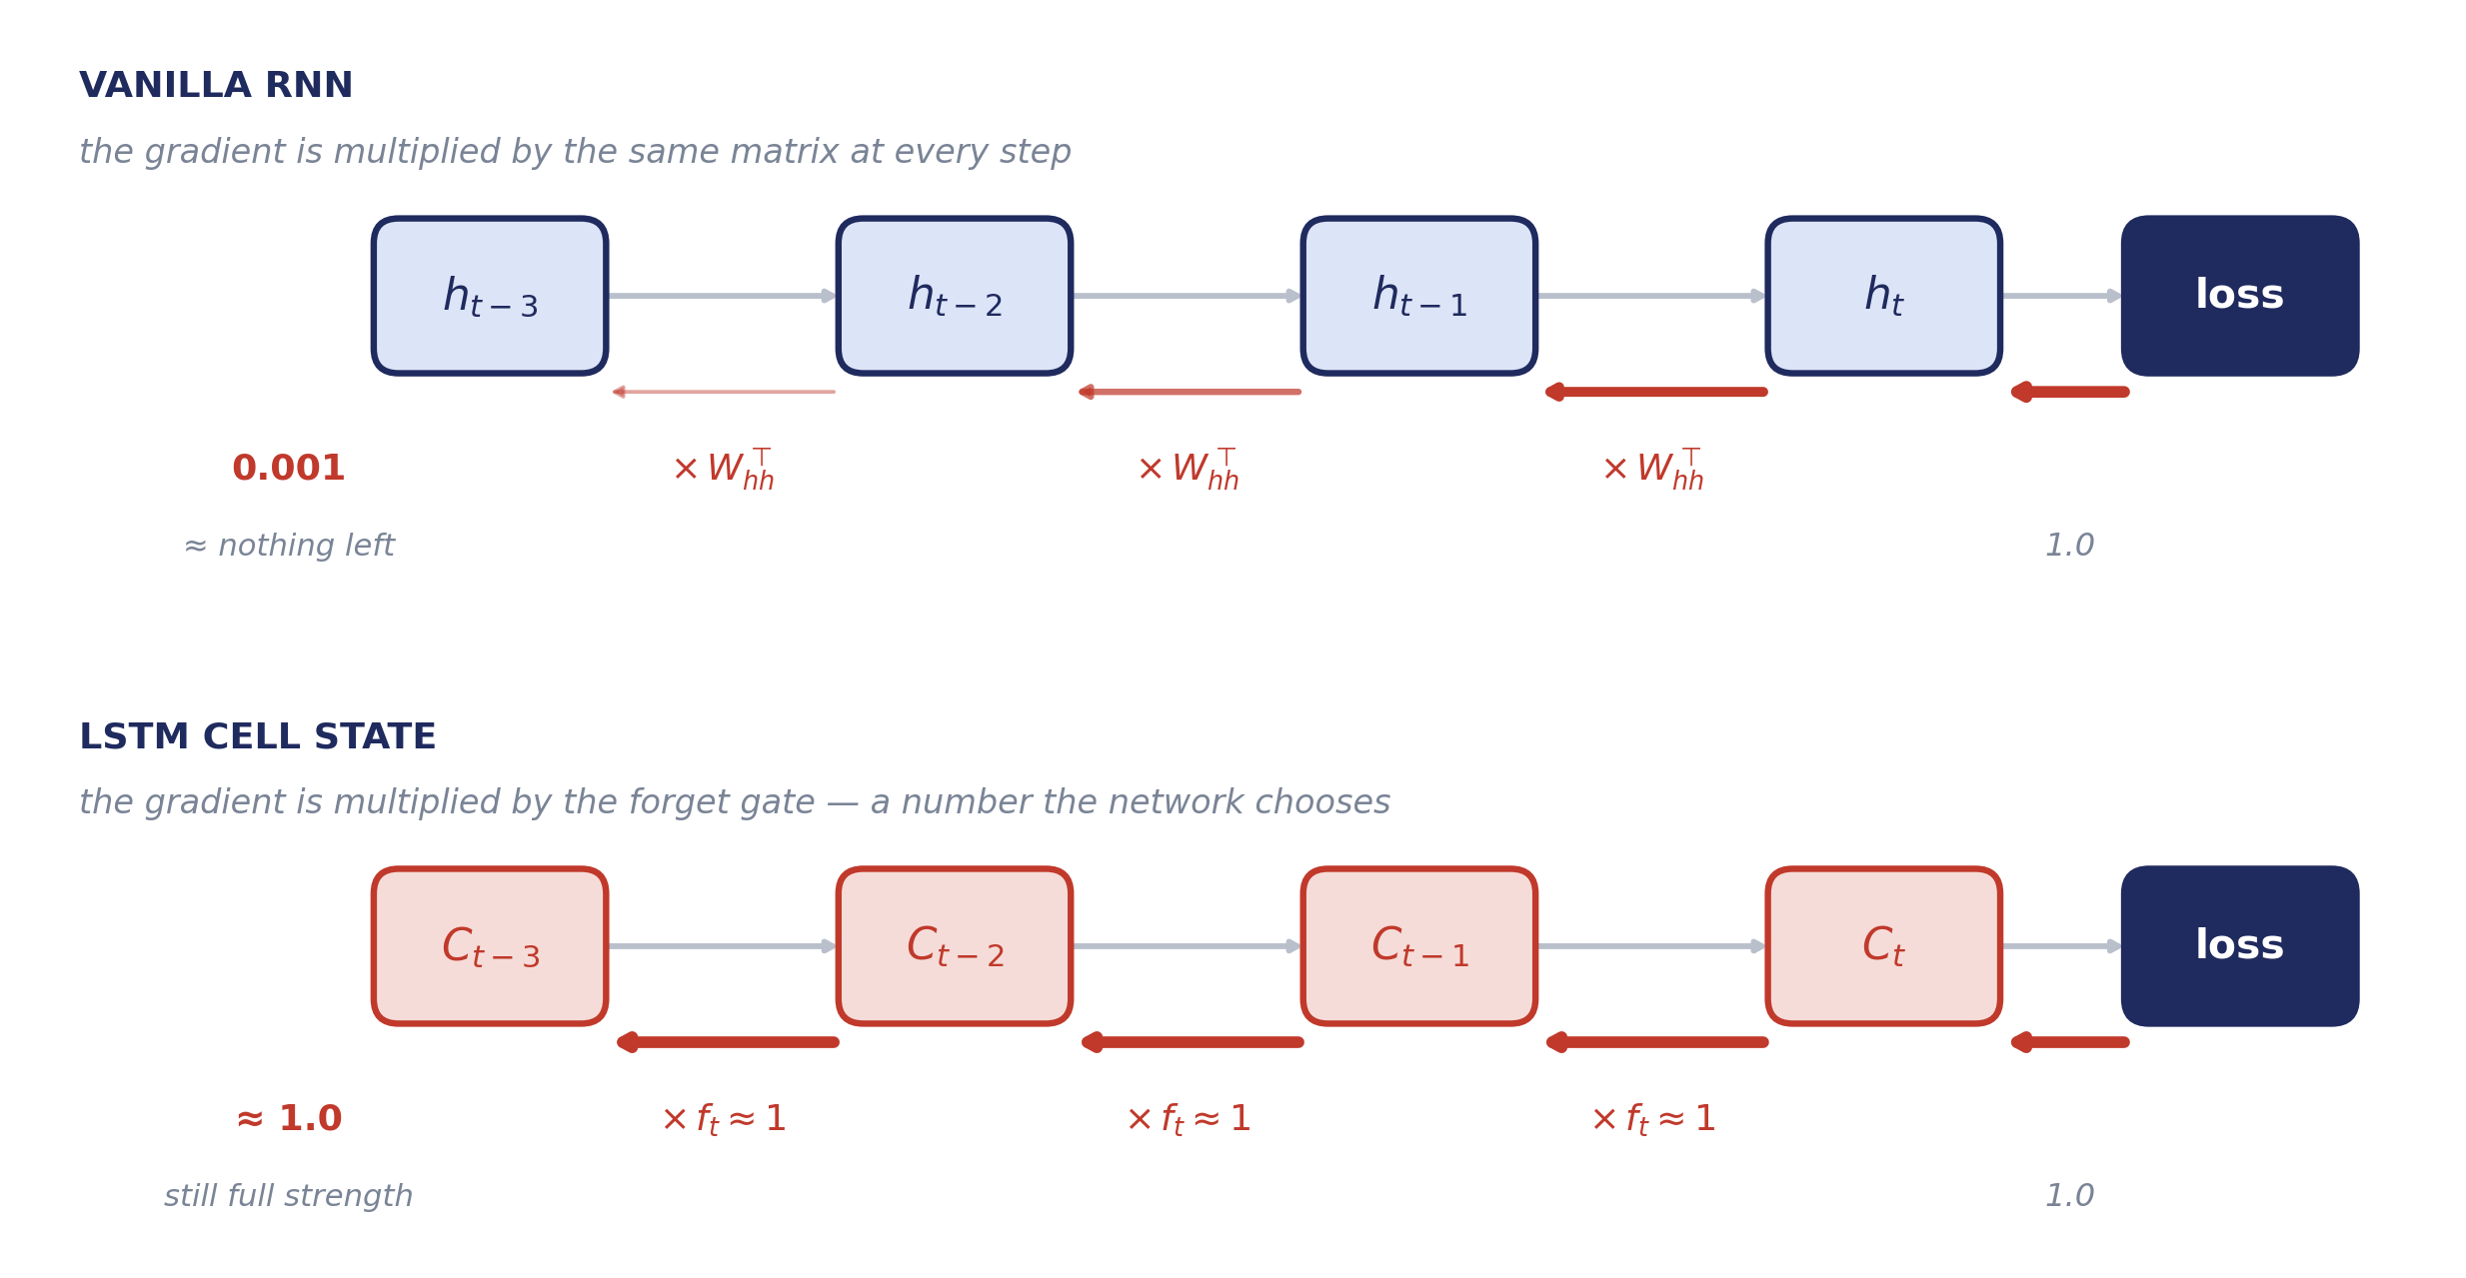
FIGURE 19.8
The same journey backwards, on two roads
Top: every step multiplies the gradient by the same matrix. Bottom: every step multiplies it by a number the network chose.
Vol. VI · Ch. 19 — Recurrent Networks, LSTM & GRU
23

Slide 24
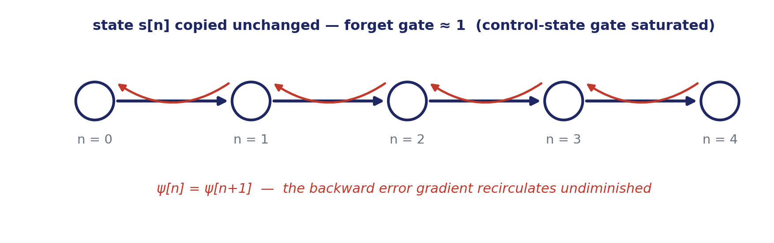
FIGURE 19.9
The Constant Error Carousel
The name Hochreiter and Schmidhuber gave to the protected, gradient-preserving path through the cell state.
Half the story: gating tackles vanishing gradients, not exploding ones — the standard fix for those is gradient clipping.
Vol. VI · Ch. 19 — Recurrent Networks, LSTM & GRU
24

Slide 25
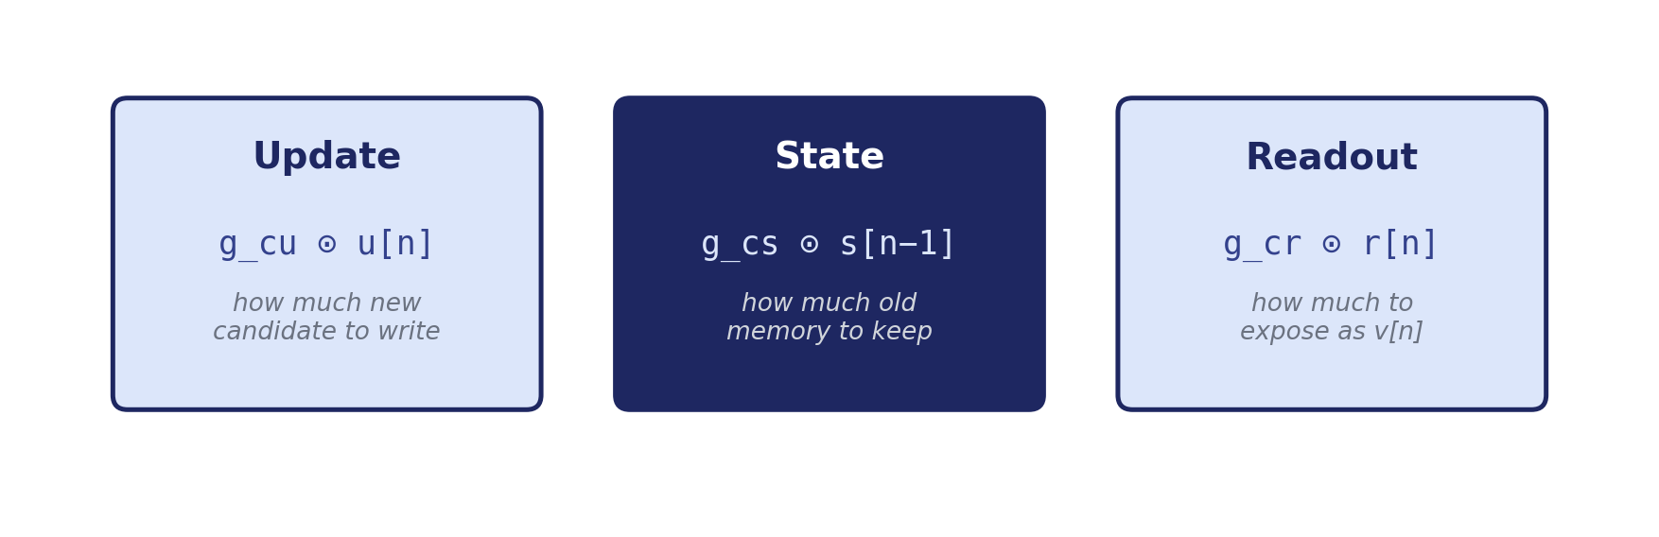
19.9 — DERIVATION
Building the gates from the RNN
Each stage pairs a data candidate (−1…1, from tanh) with a control gate (0…1, from sigmoid). The LSTM is not an arbitrary invention — it falls out of asking how to make the recurrence stable.
s[n] = g_cs[n] ⊙ s[n−1] + g_cu[n] ⊙ u[n]
Vol. VI · Ch. 19 — Recurrent Networks, LSTM & GRU
25

Slide 26
FROM LSTM TO GRU
Same trick. Fewer moving parts.
If forgetting the old and writing the new are really two sides of one decision, why use two gates for them? And if the belt already carries everything, why keep a separate hidden state at all? The GRU (2014) removes both, and loses surprisingly little.
Vol. VI · Ch. 19 — Recurrent Networks, LSTM & GRU
26

Slide 27
19.10 — THE STREAMLINED VERSION
GRU — fewer gates, same trick
The Gated Recurrent Unit (Cho et al., 2014) is a leaner descendant of the LSTM.
One gate does two jobs
One state, not two
A reset gate
The update gate z sets how much of the new candidate to take in. Whatever it takes, (1 − z) is exactly what it keeps of the old — so forgetting and writing become a single decision.
There is no separate cell state. The hidden state h is the belt, and it is also the output.
A second gate r decides how much of the old memory the candidate is even allowed to look at when it is computed.
THE ONE LINE THAT MATTERS
h_{t} = ( 1 − z_{t} ) ⊙ h_{t−1} + z_{t} ⊙ ĥ_{t}
— an interpolation between the old memory and the new candidate. Still additive, so the gradient still survives.
Vol. VI · Ch. 19 — Recurrent Networks, LSTM & GRU
27

Slide 28
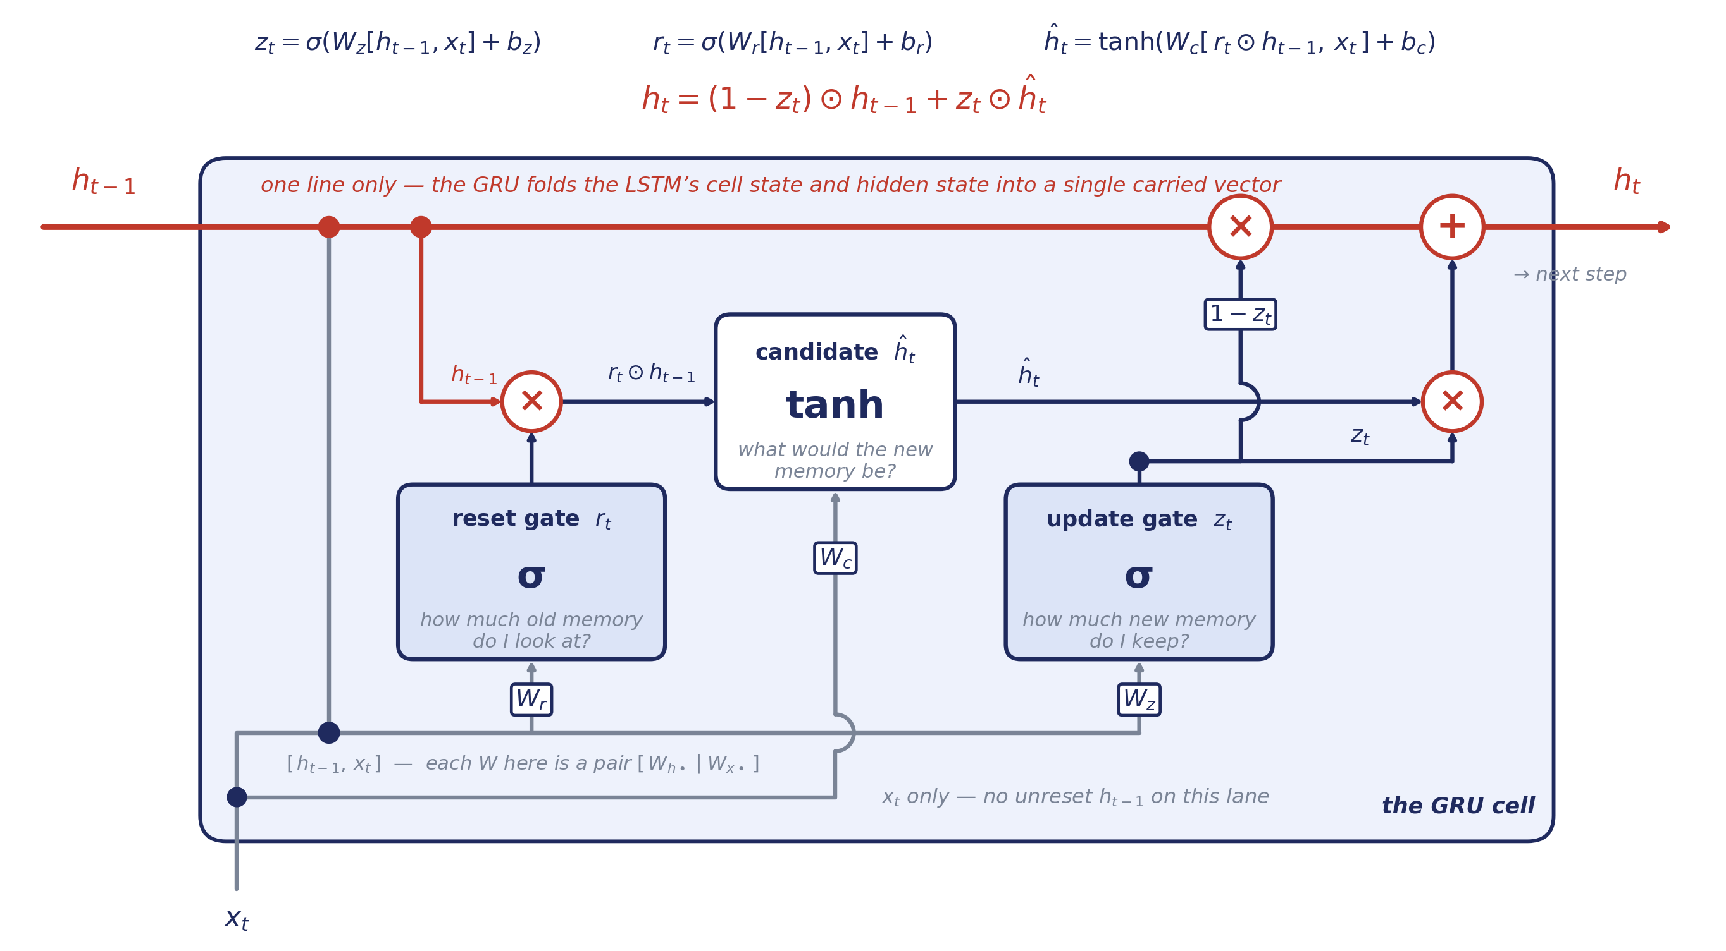
FIGURE 19.10
The GRU cell, opened up
Three weight matrices instead of four, and a single carried vector instead of two.
Vol. VI · Ch. 19 — Recurrent Networks, LSTM & GRU
28

Slide 29
READING THE DIAGRAM
Three matrices, and one clever complement
Three pairs of matrices. The h-matrix of the candidate multiplies the reset-filtered memory, not the raw one.
W_{r}
r_{t} = σ( W_{hr} h_{t−1} + W_{xr} x_{t} + b_{r} )
reset gate
Where r ≈ 0 the candidate ignores the old memory entirely.
W_{c}
ĥ_{t} = tanh( W_{hc} ( r_{t} ⊙ h_{t−1} ) + W_{xc} x_{t} + b_{c} )
candidate
Note what the h-matrix multiplies here: the reset-filtered memory, not h_{t−1} itself.
W_{z}
z_{t} = σ( W_{hz} h_{t−1} + W_{xz} x_{t} + b_{z} )
update gate
The blend weight: z on the new, (1 − z) on the old. z ≈ 0 is the gradient highway.
Set z ≈ 0 for many steps in a row and the GRU copies its memory forward verbatim — the same protected path the LSTM belt provides.
Vol. VI · Ch. 19 — Recurrent Networks, LSTM & GRU
29

Slide 30
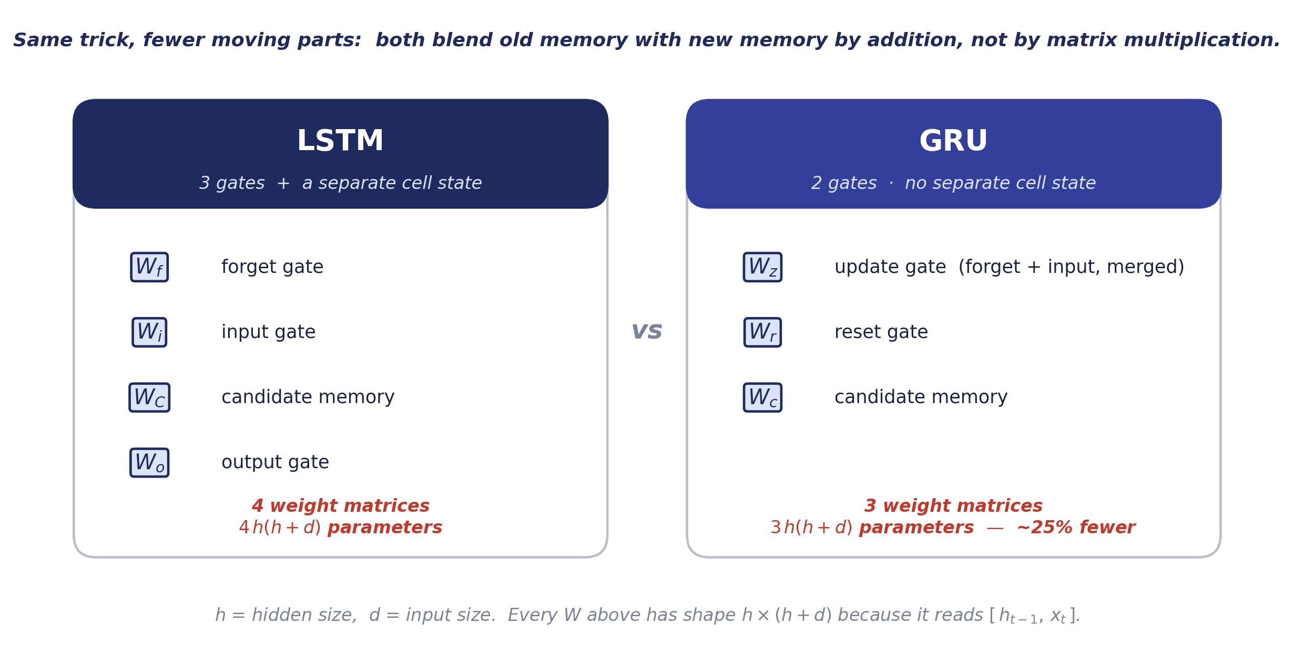
FIGURE 19.11
LSTM vs GRU, matrix by matrix
The GRU drops one matrix and one carried vector. Everything else is the same idea.
Vol. VI · Ch. 19 — Recurrent Networks, LSTM & GRU
30

Slide 31
CHOOSING A GATED CELL
GRU or LSTM?
LSTM
GRU
Gates
3 (forget, input, output)
2 (update, reset)
Separate cell state
Yes — C_t and h_t
No — folded into h_t
Parameters
More
~25% fewer
Training speed
Slower
Faster
Expressive control
Finer-grained
Coarser, but usually enough
Best when
Long, complex dependencies; plenty of data
Smaller datasets; speed matters; first thing to try
In practice: start with a GRU. Reach for an LSTM only if the GRU plateaus and you have the data to feed it.
Vol. VI · Ch. 19 — Recurrent Networks, LSTM & GRU
31

Slide 32
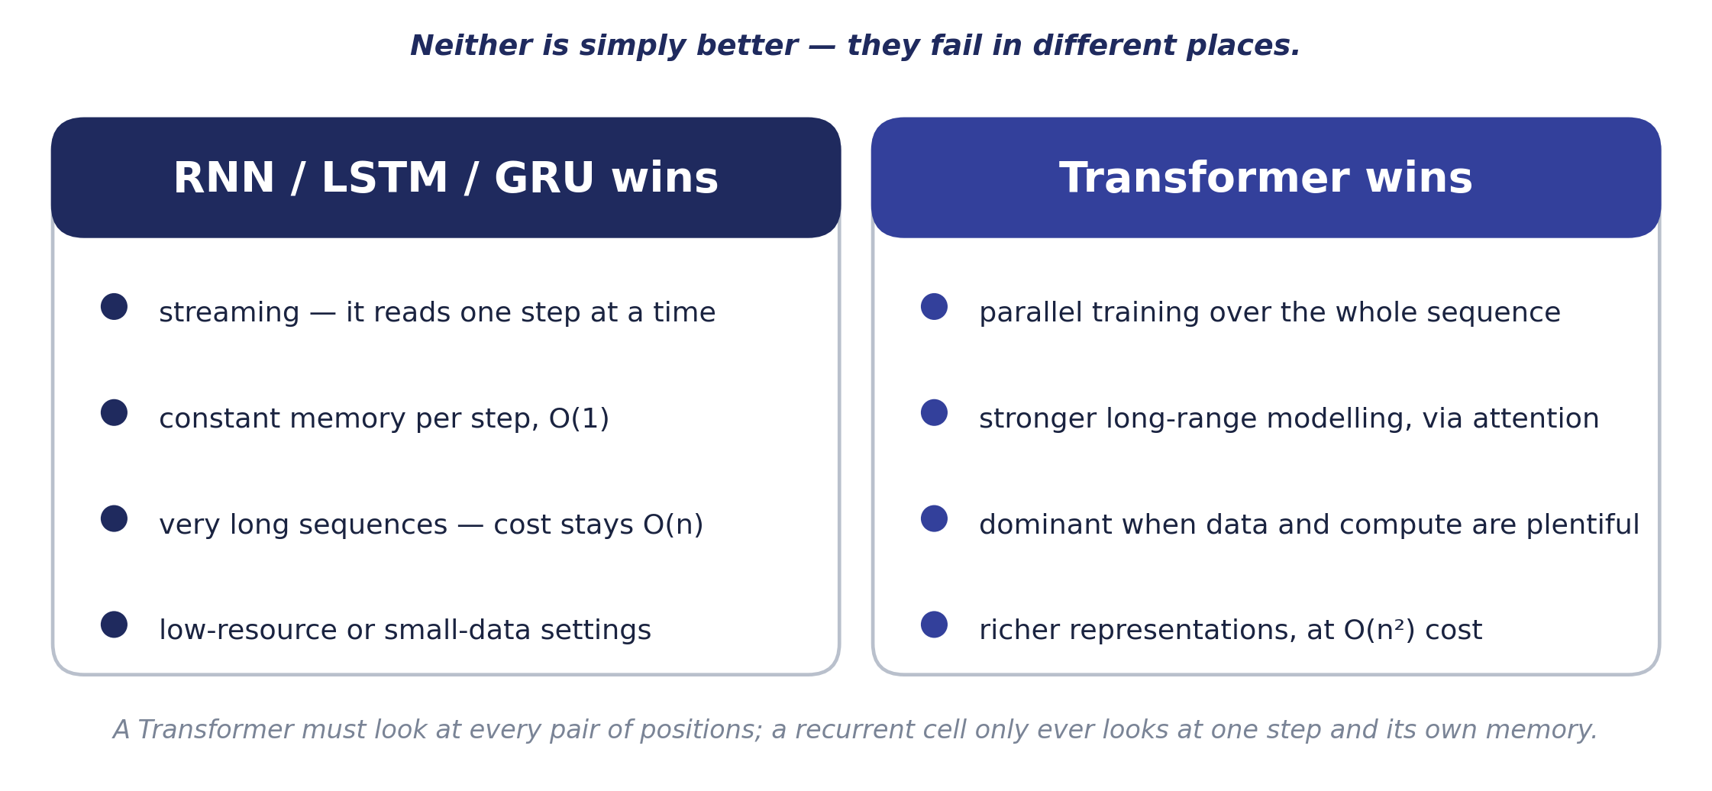
19.11 — KNOWING WHEN NOT TO USE THE FASHIONABLE TOOL
RNN / LSTM vs. Transformer
Transformers have largely superseded recurrent cells — but not everywhere.
Vol. VI · Ch. 19 — Recurrent Networks, LSTM & GRU
32

Slide 33
CHAPTER 19 IN ONE BREATH
Key takeaways
RNNs process sequences step by step, carrying a hidden-state memory and sharing one set of weight matrices — W_xh, W_hh, W_hy — across every timestep.
1
Training by backpropagation through time multiplies the gradient by W_hh once per step, so a vanilla RNN forgets anything more than about ten steps back.
2
The LSTM fixes this with a conveyor-belt cell state, updated additively and controlled by four matrices: W_f, W_i, W_C and W_o.
3
Because the update is additive, the long-range gradient becomes a product of forget-gate values that stays near 1 when memory is kept — the same trick residual connections reused eighteen years later.
4
The GRU is the streamlined two-gate version — W_z, W_r, W_c — and Transformers have largely superseded both, except for streaming, very-long-sequence and low-resource settings.
5
Vol. VI · Ch. 19 — Recurrent Networks, LSTM & GRU
33

Slide 34
End of Volume VI
Companion to Part VI of the ML/DL Handbook
SOURCES
A. Sherstinsky — “Fundamentals of Recurrent Neural Network (RNN) and Long Short-Term Memory (LSTM) Network”, Physica D (2020); arXiv:1808.03314
THE ML / DL HANDBOOK · COMPANION SERIES, VOLUME VI

